Slide 1


How is Superman able to shoot lasers out of his eyes?
Made by IU1-41B student
Andrew Soin

Slide 2
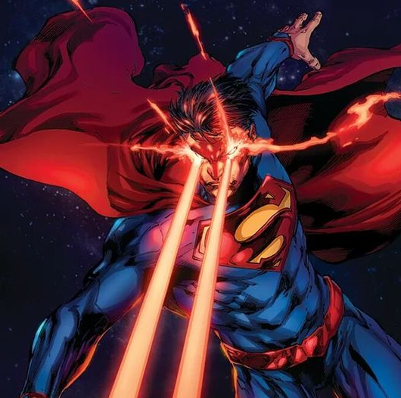
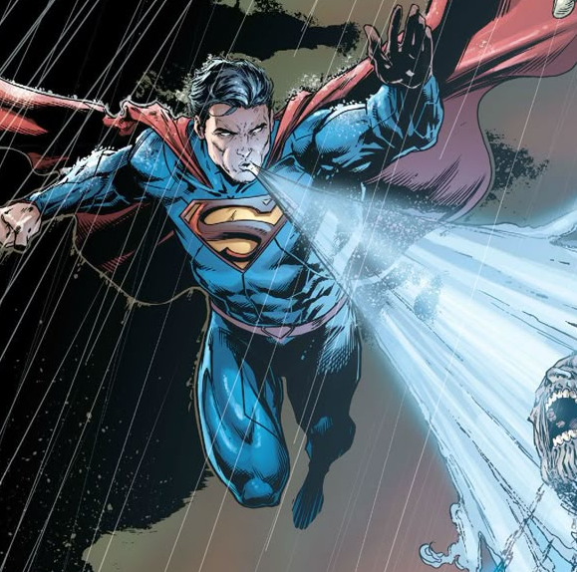

Quick recap of Superman’s powers:
Heat Vision:
Superman can emit powerful beams of heat from his eyes, allowing him to melt or burn through objects with precision.
Freeze Breath:
He can exhale air at such a low temperature that it can freeze objects or create ice.
Flight:
Superman can defy gravity and fly at high speeds

Slide 3

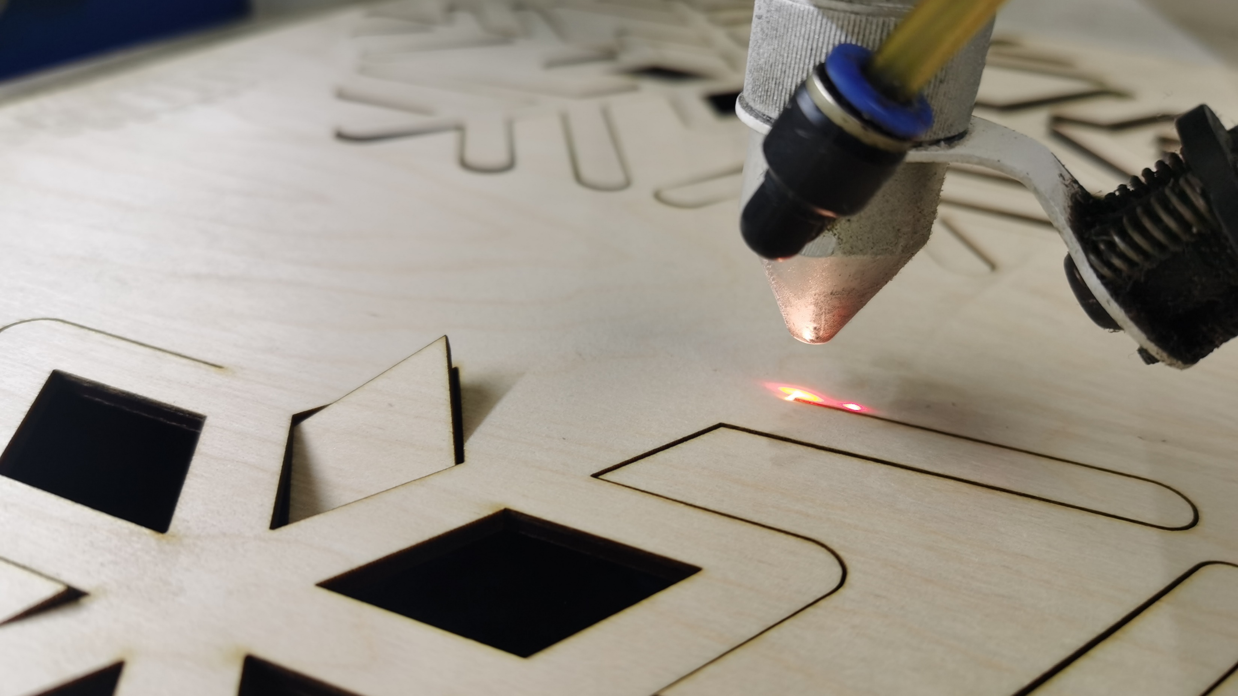
Concept of Heat Vision
Well, how can we achieve such phenomena, as heat vision, in real world?
The main way that leads us to create something like this is through the study of electromagnetic waves. Heat is one of the ways the body stores energy, and light is one of the energy carriers over a distance. So, heat vision is just a transfer of energy through the emission of electromagnetic waves. And, we already kind of achieved it.

Slide 4

Difficulties of application
But heat vision has its own difficulties of application. Firstly, its use requires a huge amount of energy, which is problematic to store in the human body (if we do not want a human explosion). Secondly, comprehensive protection of human eyes is required, otherwise, when radiating such an amount of energy, the human eye will fail.

Slide 5
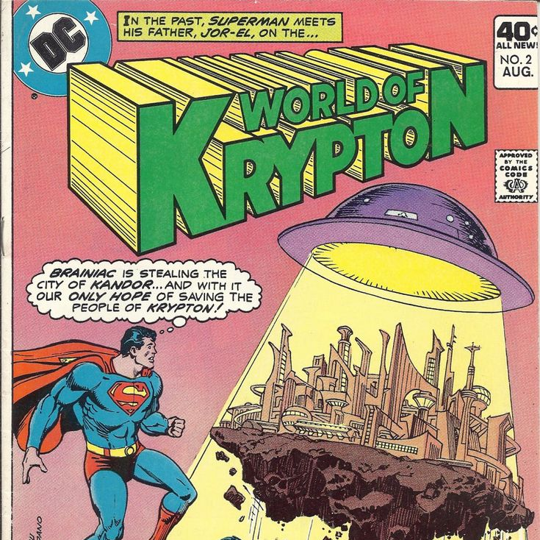
Comic book explanation
But how is Superman capable to do such things?
Superman, also known as Clark Kent or Kal-El, comes from Krypton, a planet with a different atmosphere and environment than Earth.
So, differences in biology is a main reason for his supernatural abilities.
Kryptonians, unlike humans, have cellular structures that allow them to absorb solar energy more efficiently due to their higher density and different biological composition. So, cells of Superman's body act as solar batteries, storing and harnessing energy from the sun.

Slide 6

Thanks for your attention!

